Slide 1
Outline of Today’s Discussion
Seeing the big picture in MR: Prediction
Starting SPSS on the Different Models: Stepwise versus Hierarchical
Interpreting the SPSS output box by box

Slide 2
Part 1
Seeing the Big Picture in MR:
Prediction!

Slide 3
Seeing the Big MR Picture: Prediction
No matter how hairy the output looks, just remember that MR is always about prediction!
Better still, for our purposes, MR will always be about linear prediction, which is easier than some of the non-linear regression we’ve already attempted.
Let’s re-visit the expanded version of our simplest linear equation: y = mx + b…

Slide 4
Seeing the Big MR Picture: Prediction
In the world of raw scores, the equation w/b this:
y = m₁(x₁) + m₂(x₂) + m₃(x₃) …. + b
Or, it may be simpler to ‘start’ with the intercept
y = b + m₁(x₁) + m₂(x₂) + m₃(x₃) ….

Slide 5
Seeing the Big MR Picture: Prediction
In the world of raw scores, the equation w/b this:
y = m₁(x₁) + m₂(x₂) + m₃(x₃) …. + b
Or, it may be simpler to ‘start’ with the intercept
y = b + m₁(x₁) + m₂(x₂) + m₃(x₃) ….
Remember that this is the clinically/scientifically relevant variable we’d like to predict!
Remember that SPSS calls the raw-score coefficients “unstandardized coefficients”.
Remember that SPSS calls the y-intercept “Constant”.

Slide 6
Seeing the Big MR Picture: Prediction
In the world of z-scores, the equation w/b this:
Z_{y} = β₁(Z_{x1}) + β₂(Z_{x2}) + β₃(Z_{x3}) ….
The intercept is always 0 in Z-score regression!
The row in SPSS for ‘constants’ will be blank.

Slide 7
Seeing the Big MR Picture: Prediction
In the world of z-scores, the equation w/b this:
Z_{y} = β₁(Z_{x1}) + β₂(Z_{x2}) + β₃(Z_{x3}) ….
The intercept is always 0 in Z-score regression!
The row in SPSS for ‘constants’ will be blank.
Remember that this is the clinically/scientifically relevant variable we’d like to predict!
Remember that SPSS calls the z-score coefficients “standardized coefficients”.
Remember that SPSS calls the y-intercept “Constant”.

Slide 8
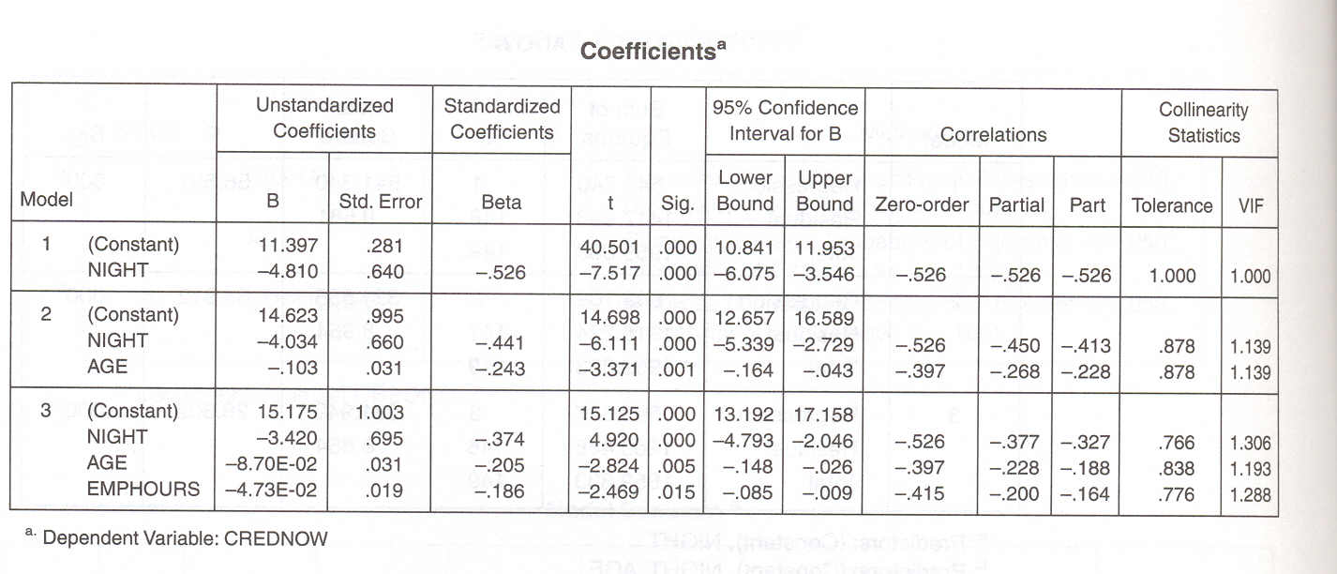
Seeing the Big MR Picture: Prediction
The coefficients for raw- or z-score prediction will come from the ‘coefficients box’ in the SPSS output.
More on that later.

Slide 9
Part 2
Stepwise MR in SPSS:
An Overview

Slide 10
MR Example Variables
Let’s define what the variables mean…
Criterion
Crednow – the number of credits that a student is taking while enrolled in a stat course.
Age – student’s age
EmpHours – the # of hours that the student works
Night – whether the student is also enrolled in night courses (yes or no)
Othact – involvement in other activities (yes/no)
Predictors

Slide 11
Stepwise MR in SPSS
In SPSS, the MR process begins the same way as for simple, one-variable regression.
Analyze → Regression → Linear
These steps in SPSS w/b used no matter whether the procedure is stepwise or hierarchical (or other MR procedures, such as ‘simultaneous’).

Slide 12
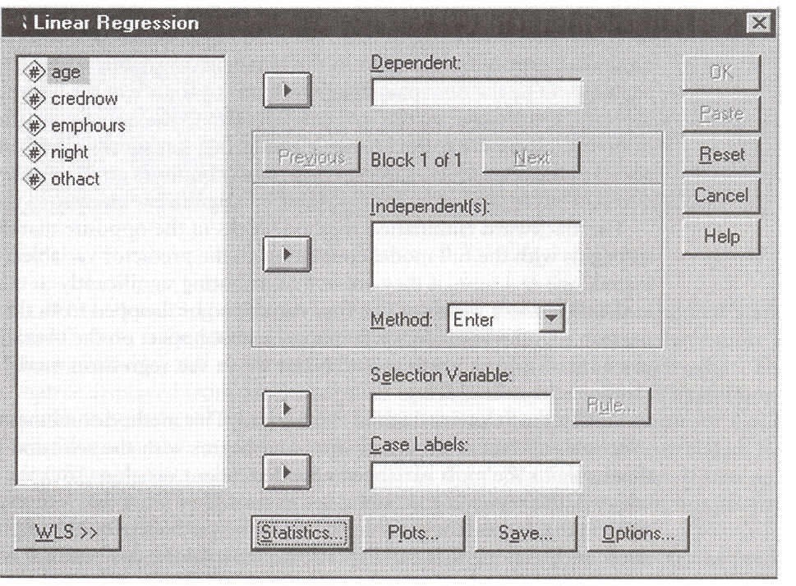
Stepwise MR in SPSS
Identify a single dependent variable (criterion),
and more than one independent variable (predictors).

Slide 13
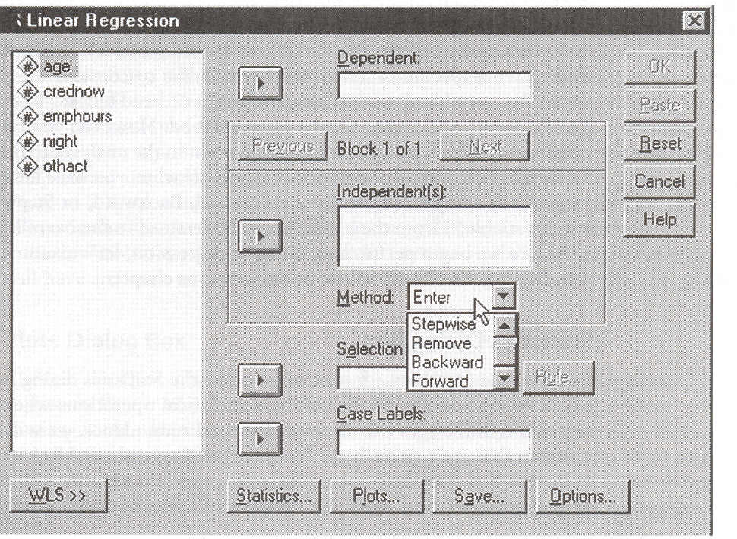
Stepwise MR in SPSS
The Method box s/b set to Stepwise.
Then click on the ‘Statistics’ box…

Slide 14
Starting SPSS on Different Models
Click on the ‘Statistics’ box to choose your statistics
FOR ANY MR MODEL

Slide 15
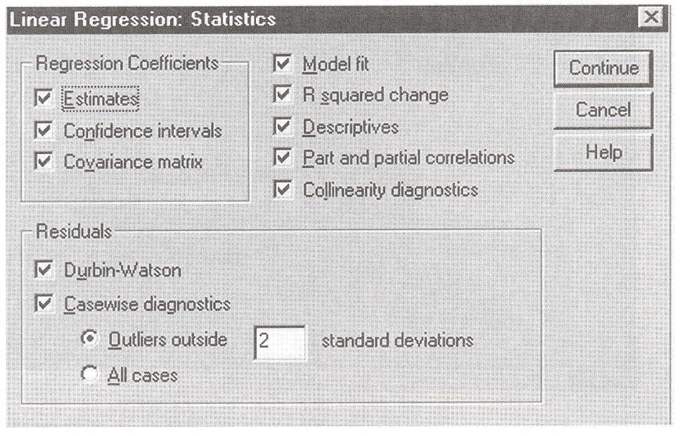
Stepwise MR in SPSS
We probably won’t need all the statistics options,
but let’s select them all for now.

Slide 16
Stepwise MR in SPSS
When your variables, method, and stats are complete,
click OK to run the multiple regression!

Slide 17
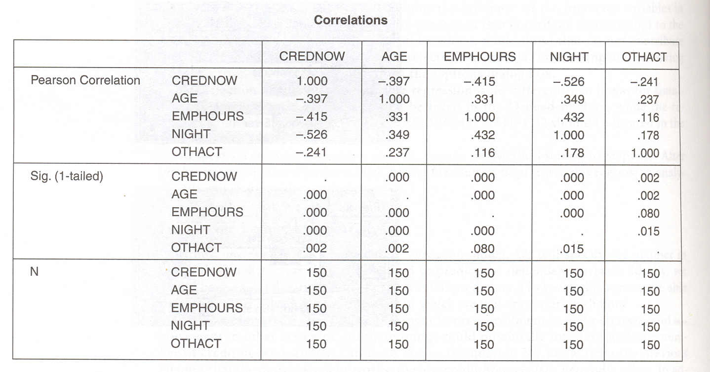
Interpreting The Output: Box by Box
The Correlations Box Could Be Helpful!
Stepwise MR in SPSS
These are the ‘zero-order’ correlations.
These do NOT depend on which MR procedure is used.

Slide 18
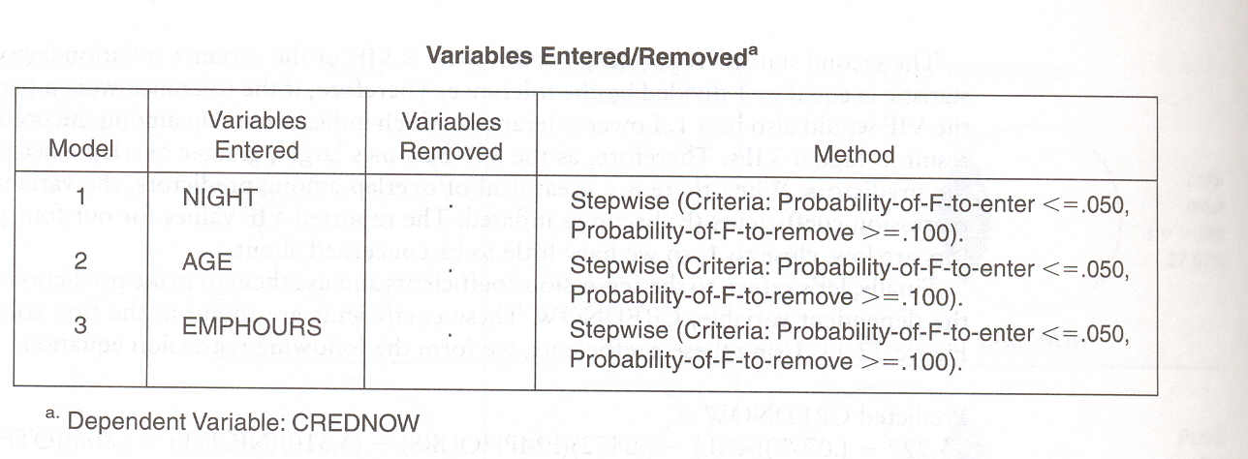
Interpreting The Output: Box by Box
IMO, The Variables Entered/Removed Box Is NOT particularly Helpful!
Notice that there are 3 different models being constructed.
Successive models have more variables entered.
Or…more variables removed if you start with the full model and exclude variables.

Slide 19
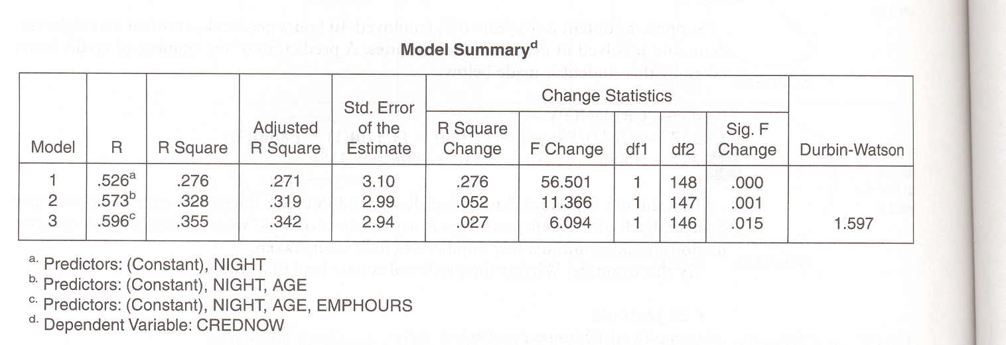
Interpreting The Output: Box by Box
The Model Summary Box Is EXTREMELY Helpful!
Notice that there are 3 different models being constructed.
You can see the INCREMENTAL value of each model by
comparing r-squared values, or r-square-change values!
The ‘footnotes’ tell you everything that the ‘variables entered/removed’ box does.

Slide 20
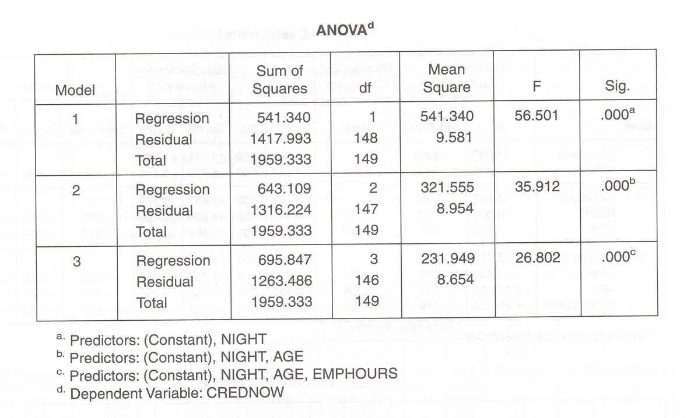
Interpreting The Output: Box by Box
IMO, The ANOVA Box Is NOT particularly Helpful!
This box would only be helpful if you needed
the ‘sum of square’ or ‘mean square’ values.
That’s unlikely!

Slide 21
Interpreting The Output: Box by Box
The Coefficients Box Is the MOST Helpful for Prediction!
Notice that there are 3 different models being constructed.
The box provides coefficients for each model!
And, it does this for raw scores (unstandardized ‘B’), and z-scores (standardized Beta)

Slide 22
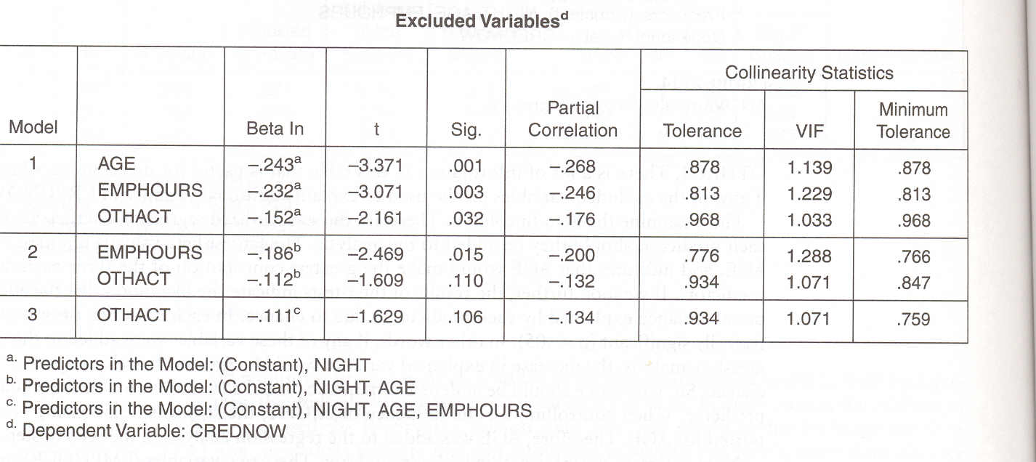
Interpreting The Output: Box by Box
IMO, The Excluded Variables Box Is NOT particularly Helpful!
The information here is largely (not entirely)
redundant with that of the other boxes.

Slide 23
Building Prediction Equations:
Coefficients are Our Friends!

Slide 24
Building the Prediction Equations
We can use the coefficients box to build our regression equations.
Remember, we can do regression equations using z-scores OR raw scores.
The z-score equations make more sense intuitively b/c the standardized beta values (standardized slopes) allow for direct comparisons across predictors that use different units of measure.

Slide 25
Building the Prediction Equations
The coefficients box helps us to build the regression equations.
Stepwise MR
We can build an equation for any of the three models shown here.
Model #3 will be the most complete.
Raw-score model first…

Slide 26
Building the Prediction Equations
The coefficients box helps us to build the regression equations.
Stepwise MR
Raw Score: CredNow = 15.175 – 3.42(night) - .087(age) - .0473(emphours)

Slide 27
Building the Prediction Equations
The coefficients box helps us to build the regression equations.
Stepwise MR
Now, the z-score model…
Z-Score: Z_{CredNow} = 0 – .374(Z_{night}) - .205(Z_{age}) - .186(Z_{emphours})

Slide 28
Building the Prediction Equations
The coefficients box helps us to build the regression equations.
Stepwise MR
Let’s go back to the raw-score equation and predict a CREDNOW score….
Assume that a particular student’s NIGHT score = 1 (s/he is a night student)
And their AGE = 50 years old
And their EMPHOURS = 40 hours per week

Slide 29
Building the Prediction Equations
The coefficients box helps us to build the regression equations.
Stepwise MR
Raw Score: CredNow = 15.175 – 3.42(1) - .087(50) - .0473(40)
Raw Score: CredNow = 15.175 – 3.42 - 4.35 – 1.892
Predicted Raw Score = 5.513 credits now

Slide 30
Part 2
Hierarchical MR in SPSS:
An Overview

Slide 31
Hierarchical MR in SPSS
In SPSS, the MR process begins the same way as for simple, one-variable regression.
Analyze → Regression → Linear
These steps in SPSS w/b used no matter whether the procedure is stepwise or hierarchical (or other MR procedures, such as ‘simultaneous’).

Slide 32
Hierarchical MR in SPSS
Identify a single dependent variable (criterion),
and more than one independent variable (predictors).

Slide 33
Hierarchical MR in SPSS
The Method box s/b set to ENTER.
Note: There is no ‘hierarchical’ option, per se.
Then click on the ‘Statistics’ box…

Slide 34
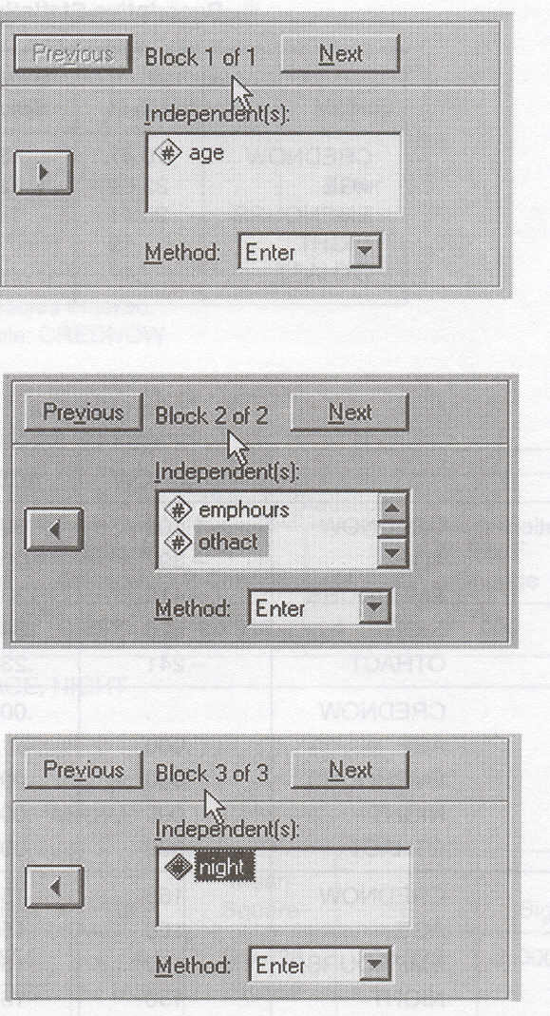
Starting SPSS on Different Models
Within the Method box,
there is no option called
“hierarchical”.
We have to “ENTER”
our hierarchy of variables
manually, using the previous
and next buttons to
specify the order of blocks.
Example: Block 1 of 1
Example: Block 2 of 2
Example: Block 3 of 3

Slide 35
Hierarchical MR in SPSS
We probably won’t need all the statistics options,
but let’s select them all for now.

Slide 36
Hierarchical MR in SPSS
When your variables, method, and stats are complete,
click OK to run the multiple regression!

Slide 37
Hierarchical MR in SPSS
These are the ‘zero-order’ correlations.
These do NOT depend on which MR procedure is used.

Slide 38
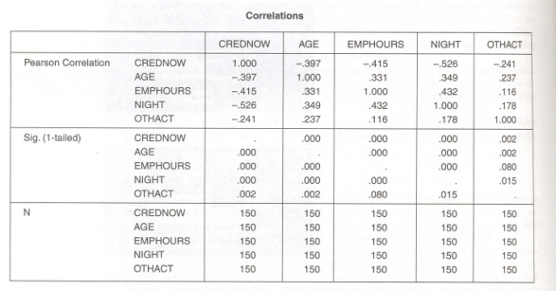
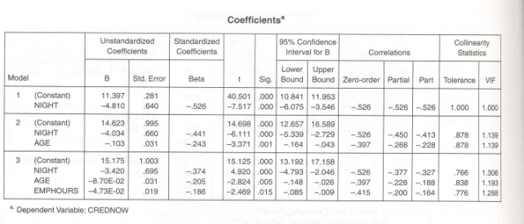
Interpreting The Output: Box by Box
So, here are the three most helpful boxes (“CMC”)
Correlations
Answers the question:
What’s correlated with what?
Model Summary
Answers the question:
How good are the models?
Coefficients
Answers the question:
What are my coefficients?
(Used for prediction… the big picture!)

Slide 39
Part 3
Interpreting Differences
Between the Two Models

Slide 40
Differences Between The Models
We can compare the two models in several ways.
First, we might consider the models within the context of “Ockham’s Razor”…
In other words, how much variance does each model explain ‘per unit complexity’?
That is, fewer variables w/b better ALL OTHER THINGS BEING EQUAL.

Slide 41
Differences Between The Models
Stepwise
MR
Model
Hierarchical
MR
Model

Slide 42
Differences Between The Models
We can also compare the regression equations for each type of model.
Remember, we can do regression equations using z-scores OR raw scores.
The z-score equations make more sense intuitively b/c the standardized beta values (standardized slopes) allow for direct comparisons across predictors that use different units of measure.

Slide 43
Differences Between The Models
Stepwise MR
Raw Score: CredNow = 15.175 – 3.42(night) - .087(age) - .0473(emphours)
Z-Score: Z_{CredNow} = 0 – .374(Z_{night}) - .205(Z_{age}) - .186(Z_{emphours})

Slide 44
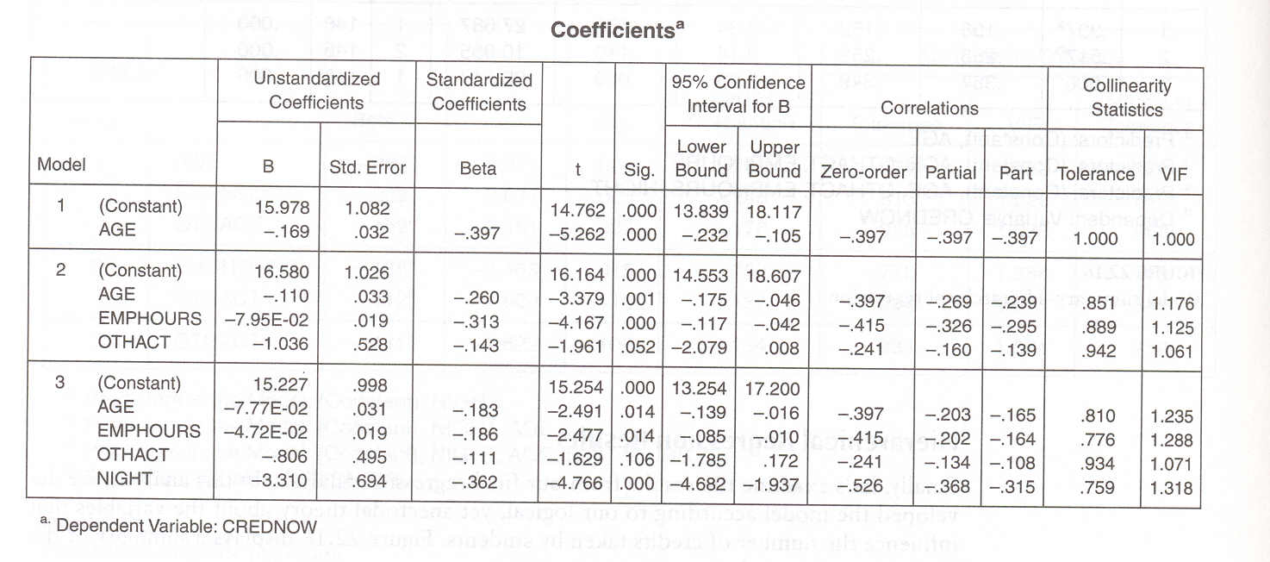
Differences Between The Models
Hierarchical MR
Raw Score: CredNow = 15.227 – 3.31(night) - .0078(age) - .0473(emphours) - .806(othact)
Z-Score: Z_{CredNow} = 0 – .362(Z_{night}) - .183(Z_{age}) - .186(Z_{emphours}) - .111(Z_{othact})

Slide 45
Differences Between The Models
Here are the ‘competing’ Raw Score Regression Models
Stepwise (r² = 0.355) with 3 variables
Raw Score: CredNow = 15.175 – 3.42(night) - .087(age) - .0473(emphours)
Hierarchical (r² = 0.367) with 4 variables
Raw Score: CredNow = 15.227 – 3.31(night) - .0078(age) - .0473(emphours) - .806(othact)

Slide 46
Differences Between The Models
Here are the ‘competing’ Z-Score Regression Models
Stepwise (r² = 0.355) with 3 variables
Z-Score: ZCredNow = 0 – .374(Z_{night}) - .205(Z_{age}) - .186(Z_{emphours})
Hierarchical (r² = 0.367) with 4 variables
Z-Score: Z_{CredNow} = 0 – .362(Z_{night}) - .183(Z_{age}) - .186(Z_{emphours}) - .111(Z_{othact})

